Slide 1
Experiment Details
This experiment involves plotting histograms of pixel intensities for image transformations at different alpha values. The goal is to analyze how varying alpha values affect the distribution of pixel intensities when transforming non-spiculated images to spiculated and vice versa.
For each alpha value:
Pixel intensity distributions are captured and plotted in histograms.
The analysis focuses on observing any shifts in distribution and understanding the influence of alpha on image characteristics.

Slide 2
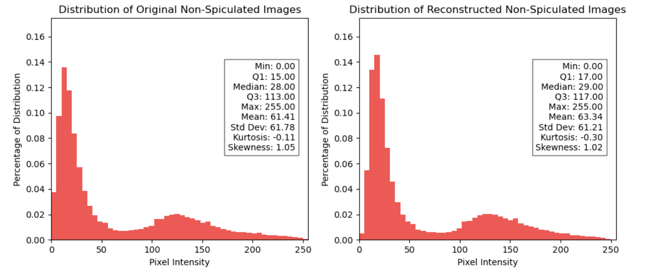
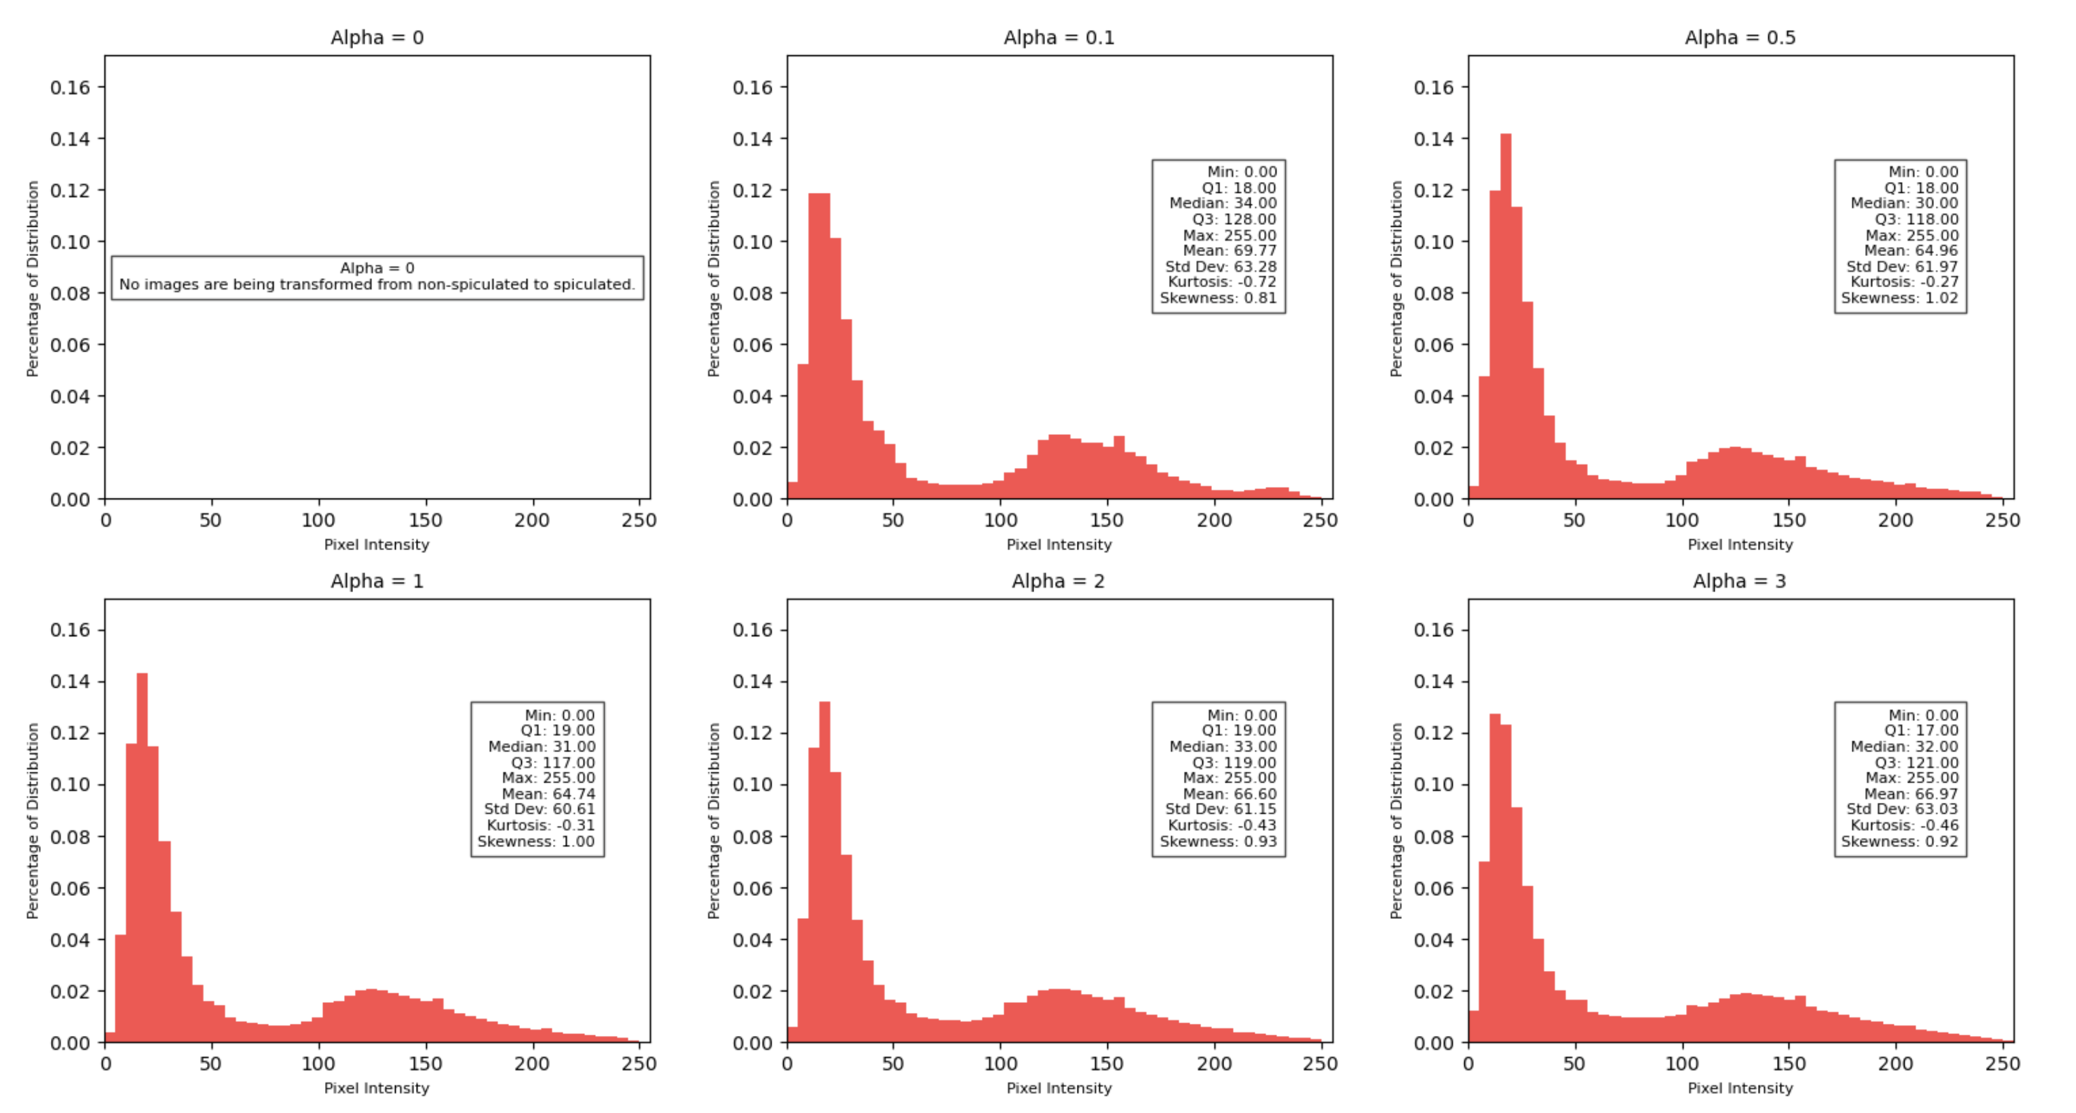
Histogram of Non-Spiculated
Images

Slide 3
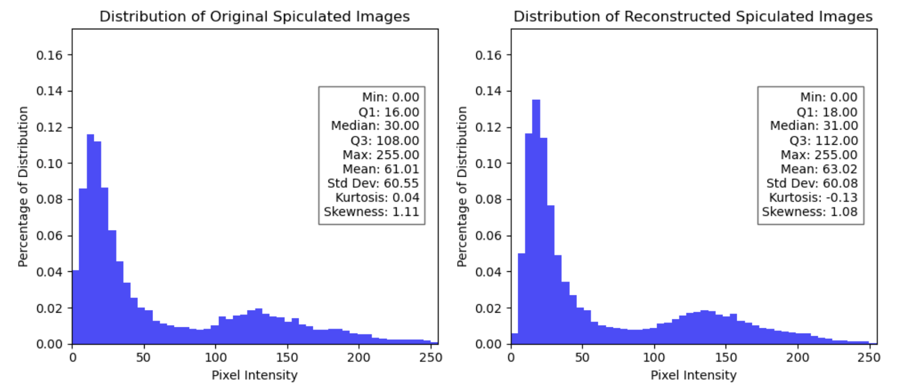
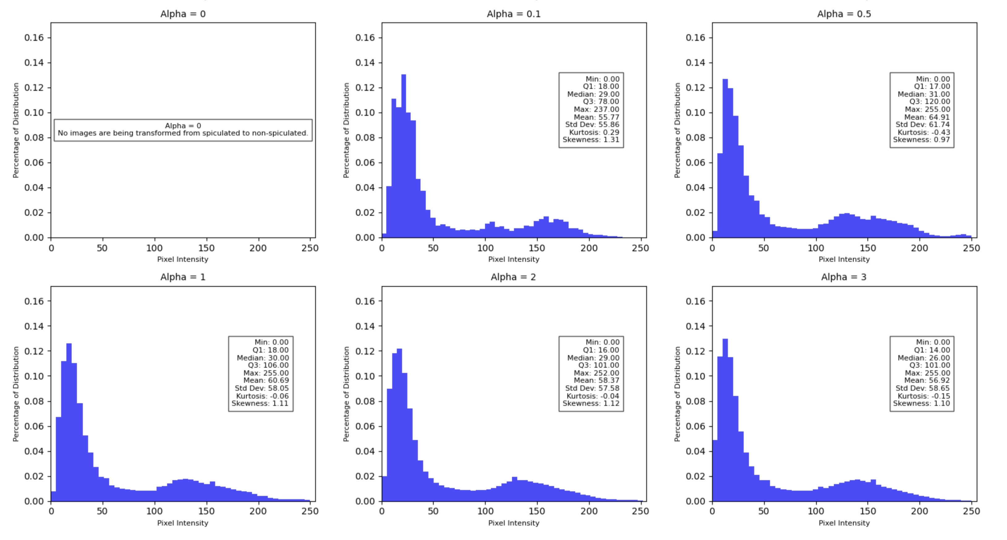
Histogram of Spiculated
Images

Slide 4
Interpretation & Analysis
For the transformation from non-spiculated to spiculated images, and vice versa:
We observe that the overall distribution of pixel intensities remains consistent across different values of alpha.
Varying alpha values does not significantly shift the distribution.
This is because the distribution we are analyzing is based on pixel intensity levels, which capture general brightness and contrast but do not capture finer semantic details, such as spicules.
Changes in alpha influence image intensities rather than the semantic characteristics that define spiculation.

Slide 5






Results: Validating Latent Representation Variations for Capturing Spiculation Semantic Characteristics
Human Label LRR Cluster Label | Non-Spiculated | Spiculated
Non-Spiculated | 2268 | 2
Spiculated | 25 | 163
Observing the effect of LRR Cluster label ‘Non-Spiculated’ and LRV cluster label ‘Non-Spiculated’ and ‘Spiculated’
$∝$ = 0
$∝$ = 0.1
$∝$ = 0.5
LRR Cluster Label LRV Cluster Label | Non-Spiculated | Spiculated
Non-Spiculated | 2270 | 0
Spiculated | 0 | 188
LRR Cluster Label LRV Cluster Label | Non-Spiculated | Spiculated
Non-Spiculated | 2228 | 9
Spiculated | 42 | 179
LRR Cluster Label LRV Cluster Label | Non-Spiculated | Spiculated
Non-Spiculated | 1144 | 70
Spiculated | 1126 | 118
$∝$ = 1
$∝$ = 2
$∝$ = 3
LRR Cluster Label LRV Cluster Label | Non-Spiculated | Spiculated
Non-Spiculated | 18 | 163
Spiculated | 2252 | 25
LRR Cluster Label LRV Cluster Label | Non-Spiculated | Spiculated
Non-Spiculated | 2 | 163
Spiculated | 2268 | 25
LRR Cluster Label LRV Cluster Label | Non-Spiculated | Spiculated
Non-Spiculated | 2 | 163
Spiculated | 2268 | 25
LRR: Latent Representation Reconstruction
LRV : Latent Representation Variation
VAE LRVs effectively transforms the non-spiculation semantic characteristic to spiculation semantic characteristic as we increase the step size $∝$

Slide 6
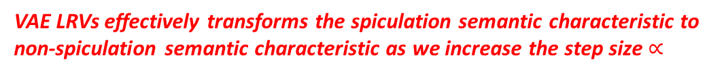
Results: Validating Latent Representation Variations for Capturing Spiculation Semantic Characteristics
Human Label LRR Cluster Label | Non-Spiculated | Spiculated
Non-Spiculated | 2268 | 2
Spiculated | 25 | 163
Observing the effect of LRR Cluster label ‘Spiculated’ and LRV cluster label ‘Non-Spiculated’ and ‘Spiculated’
$∝$ = 0
$∝$ = 0.1
$∝$ = 0.5
LRR Cluster Label LRV Cluster Label | Non-Spiculated | Spiculated
Non-Spiculated | 2270 | 0
Spiculated | 0 | 188
LRR Cluster Label LRV Cluster Label | Non-Spiculated | Spiculated
Non-Spiculated | 2228 | 9
Spiculated | 42 | 179
LRR Cluster Label LRV Cluster Label | Non-Spiculated | Spiculated
Non-Spiculated | 1144 | 70
Spiculated | 1126 | 118
$∝$ = 1
$∝$ = 2
$∝$ = 3
LRR Cluster Label LRV Cluster Label | Non-Spiculated | Spiculated
Non-Spiculated | 18 | 163
Spiculated | 2252 | 25
LRR Cluster Label LRV Cluster Label | Non-Spiculated | Spiculated
Non-Spiculated | 2 | 163
Spiculated | 2268 | 25
LRR Cluster Label LRV Cluster Label | Non-Spiculated | Spiculated
Non-Spiculated | 2 | 163
Spiculated | 2268 | 25
LRR: Latent Representation Reconstruction
LRV : Latent Representation Variation
VAE LRVs effectively transforms the spiculation semantic characteristic to non-spiculation semantic characteristic as we increase the step size $∝$

